Slide 1

18ECC205J – Analog and Digital Communication
Course Credit : 4
Theory : 9 Hours
1. Singh. R. P & Sapre. S. D, “Communication Systems: Analog & Digital,” 3rd edition, McGrawHill Education, Seventh Reprint, 2016. 2. Simon Haykin, “Communication Systems”, John Wiley & Sons, 4th Edition, 2008

Slide 2
Course Outline
ADC
1. Analog Modulation
2. Radio Transmitters and Receivers
3. Digital Modulation System and Baseband Detection
4. Passband Data Transmission
5. Spread Spectrum Techniques and Information theory Concepts

Slide 3
Unit 4 – Pass band Data Transmission
Overview of ASK, FSK, PSK
Generation, Signal Space Diagram and detection of FSK
Probability of Error for FSK
Generation, Detection, Signal Space Diagram of PSK
Probability of Error for PSK
Generation, signal space diagram and detection of QPSK
Probability of Error for QPSK
Generation, signal space diagram and detection of π/4 QPSK
Generation, signal space diagram and detection of QAM

Slide 4
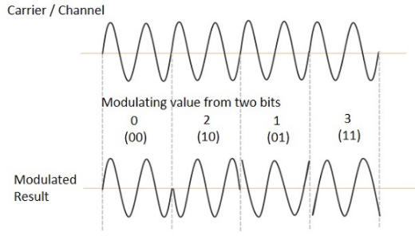
QPSK - Quadrature Phase Shift Keying
Quadrature Phase Shift Keying QPSK
QPSK is a variation of BPSK, and it is also a Double Side Band Suppressed Carrier modulation scheme, which sends two bits of digital information at a time, called as bigits.
This is the phase shift keying technique, in which the sine wave carrier takes four phase reversals such as 0°, 90°, 180°, and 270°.
Instead of the conversion of digital bits into a series of digital stream, it converts them into bit pairs. This decreases the data bit rate to half, which allows space for the other users.
If this kind of techniques are further extended, PSK can be done by eight or sixteen values also, depending upon the requirement.
.

Slide 5
QPSK - Quadrature Phase Shift Keying
Types of QPSK
Offset QPSK (OQPSK)
π/4 – QPSK
π/4 shifted version of QPSK
π/4 – DQPSK
.

Slide 6
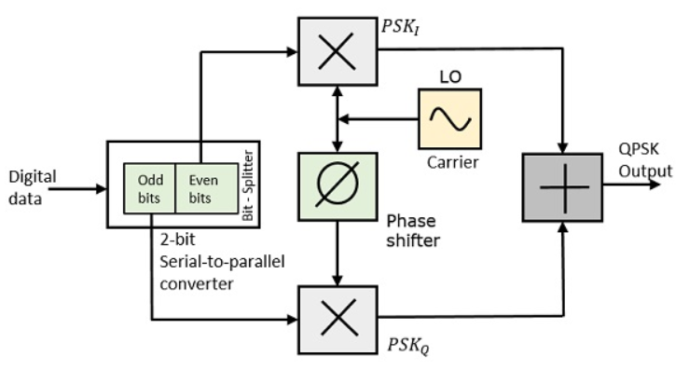
QPSK - Quadrature Phase Shift Keying
At the modulator’s input, the message signal’s even bits (i.e., 2nd bit, 4th bit, 6th bit, etc.) and odd bits (i.e., 1st bit, 3rd bit, 5th bit, etc.) are separated by the bits splitter.
They are multiplied with the same carrier to generate odd BPSK (called as PSK_{I}) and even BPSK (called as PSK_{Q}).
The PSK_{Q} signal is phase shifted by 90° before being modulated.
The QPSK waveform shows that the modulated result for different instances of binary inputs.
The QPSK Modulator uses a bit-splitter, two multipliers with local oscillator, a 2-bit serial to parallel converter, and a summer circuit.

Slide 7
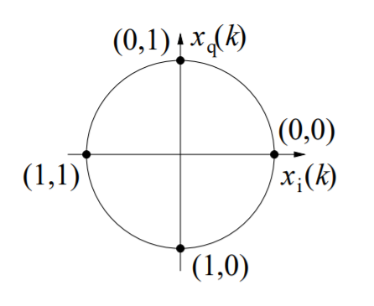
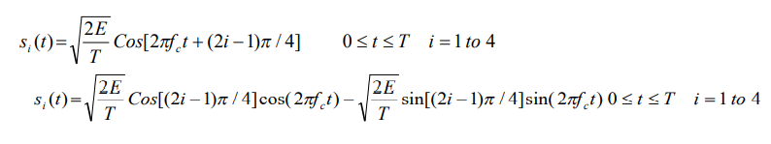
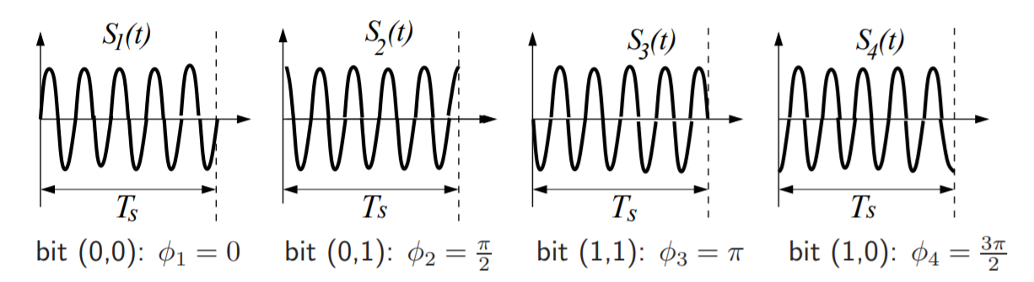
QPSK - Quadrature Phase Shift Keying
In case of QPSK the carrier is given by
Two bits per symbol with a minimum phase separation of π/2

Slide 8
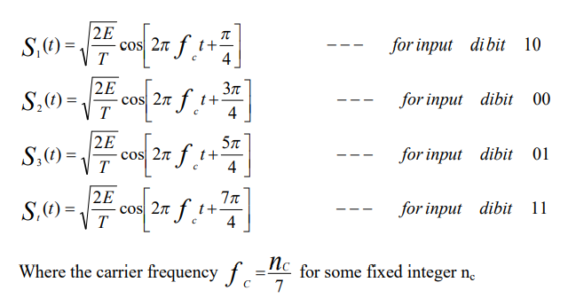

QPSK - Quadrature Phase Shift Keying
In QPSK system the information carried by the transmitted signal is contained in the phase. The transmitted signals are given by

Slide 9
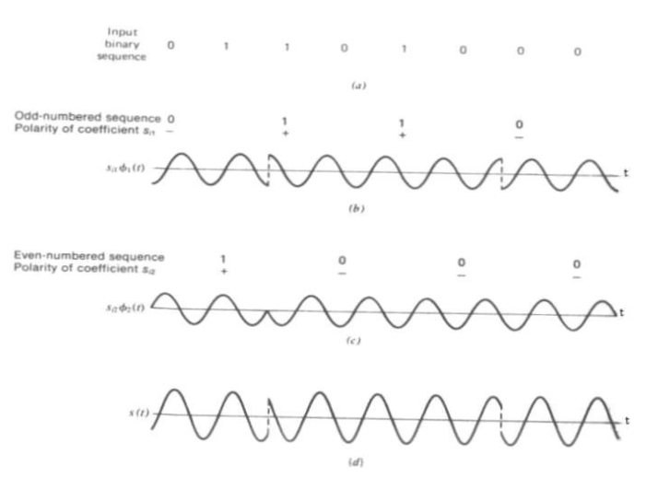
QPSK - Quadrature Phase Shift Keying

Slide 10
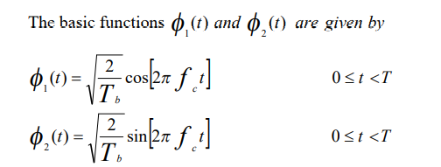
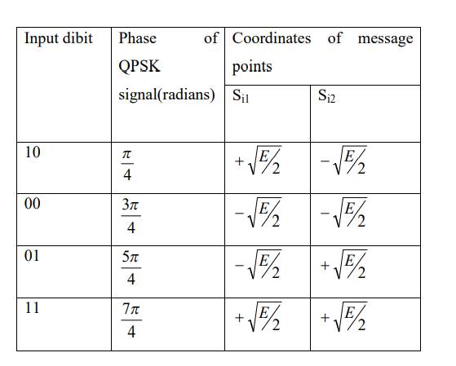
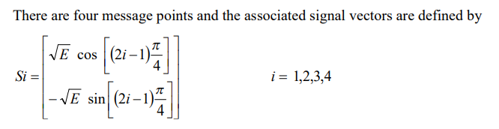
QPSK - Quadrature Phase Shift Keying

Slide 11
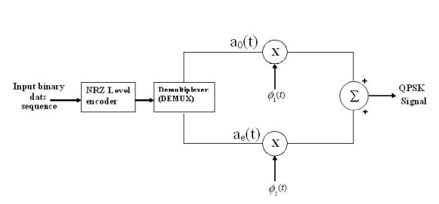
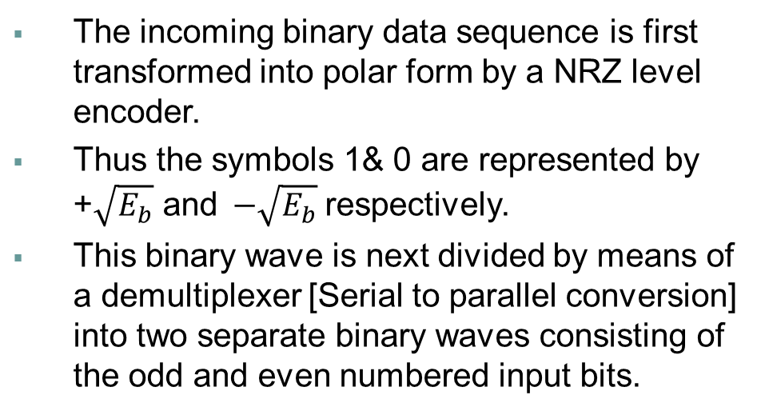
QPSK – Generation
The incoming binary data sequence is first transformed into polar form by a NRZ level encoder.
Thus the symbols 1& 0 are represented by +$\sqrt{E_{b}}$ and$−\sqrt{E_{b}}$respectively.
This binary wave is next divided by means of a demultiplexer [Serial to parallel conversion] into two separate binary waves consisting of the odd and even numbered input bits.
These two binary waves are denoted by a_{o}(t) and a_{e}(t).
The two binary waves a_{o}(t) and a_{e}(t) are used to modulate a pair of quadrature carriers or orthonormal basis functions ϕ₁(t) and ϕ₂(t)

Slide 12
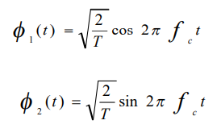
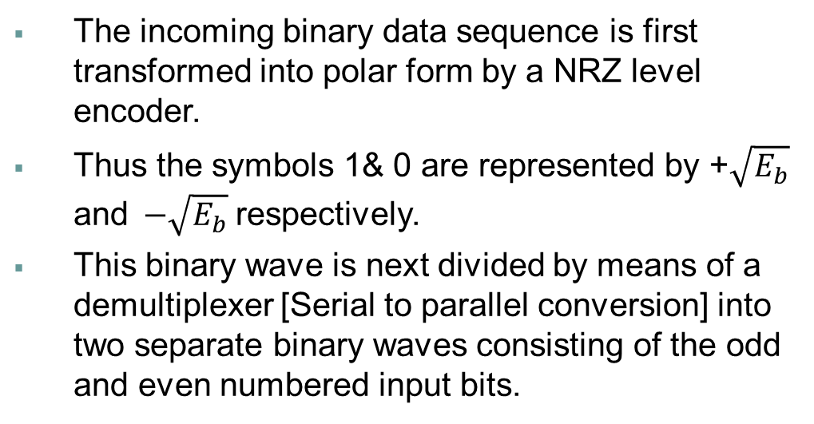
QPSK – Generation
The incoming binary data sequence is first transformed into polar form by a NRZ level encoder.
Thus the symbols 1& 0 are represented by +$\sqrt{E_{b}}$ and$−\sqrt{E_{b}}$respectively.
This binary wave is next divided by means of a demultiplexer [Serial to parallel conversion] into two separate binary waves consisting of the odd and even numbered input bits.
These two binary waves are denoted by a_{o}(t) and a_{e}(t).
The two binary waves a_{o}(t) and a_{e}(t) are used to modulate a pair of quadrature carriers or orthonormal basis functions ϕ₁(t) and ϕ₂(t)
The result is a pair of binary PSK signals, which may be detected independently due to the orthogonality of ϕ₁(t) and ϕ₂(t). Finally the two binary PSK signals are added to produce the desired QPSK signal

Slide 13
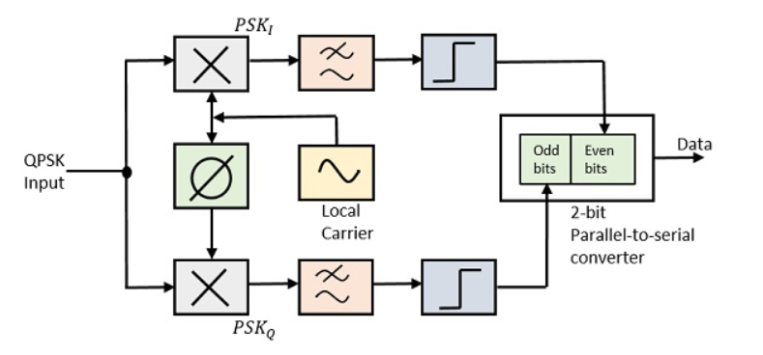
QPSK Demodulator
The two product detectors at the input of demodulator simultaneously demodulate the two BPSK signals.
The pair of bits are recovered here from the original data.
These signals after processing, are passed to the parallel to serial converter.
QPSK Demodulator uses 2 product demodulator circuits with local oscillator, 2 band pass filters, 2 integrator scircuits, and a 2-bit parallel to serial converter.

Slide 14
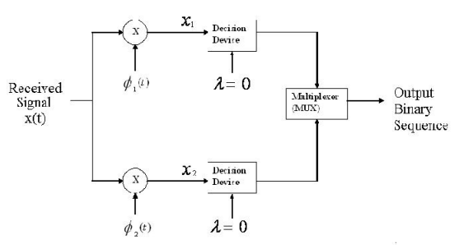
QPSK – Detection
The QPSK receiver consists of a pair of correlators with a common input and supplied with a locally generated pair of coherent reference signals ϕ₁(t) and ϕ₂(t).
The correlator outputs x₁ and x₂ produced in response to the received signal x(t) are each compared with a threshold value of zero.
The in-phase channel output :
If x1 > 0 a decision is made in favour of symbol 1
If x1 < 0 a decision is made in favour of symbol 0
The quadrature channel output:
If x2 >0 a decision is made in favour of symbol 1
If x2 <0 a decision is made in favour of symbol 0
Finally these two binary sequences at the in phase and quadrature channel outputs are
combined in a multiplexer (Parallel to Serial) to reproduce the original binary sequence.

Slide 15
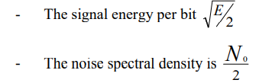
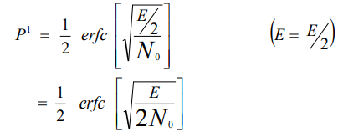
QPSK – Probability of Error
A QPSK system is equivalent to two coherent binary PSK systems working in parallel.
It uses carriers that are in-phase and quadrature.
The in-phase channel output x1 and the Q-channel output x2 may be viewed as the individual outputs of the two coherent binary PSK systems.
Thus the two binary PSK systems may be characterized as follows
The average probability of bit error in each channel of the coherent QPSK system is

Slide 16
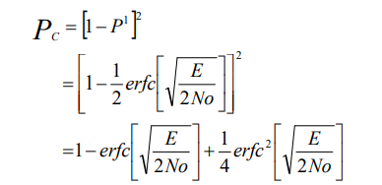
QPSK – Probability of Error
The bit errors in the I-channel and Q-channel of the QPSK system are statistically independent .
The I-channel makes a decision on one of the two bits constituting a symbol (di bit) of the QPSK signal and the Q-channel takes care of the other bit.
The average probability of a direct decision resulting from the combined action of the two channels working together is
P_{c}= probability of correct reception
P¹= probability of error

Slide 17
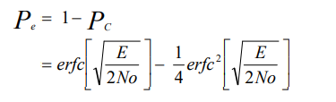

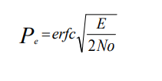
QPSK – Probability of Error
The average probability of symbol error for coherent QPSK is given by
the second term may be ignored and so the approximate formula for the average probability of symbol error for coherent QPSK system is

